Slide 1
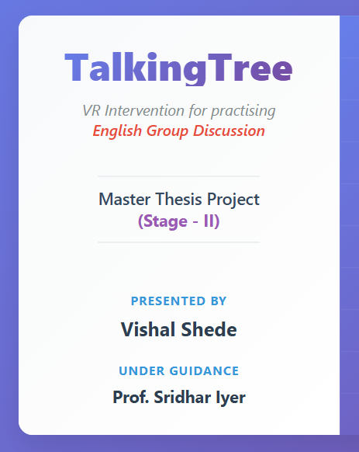

TalkingTree
VR Intervention for practising
English Group Discussion
Master Thesis Project
(Stage - II)
Presented by
Vishal Shede
Under Guidance
Prof. Sridhar Iyer
Notes:
Hello Everyone! Thank you for being here today. My name is Vishal Shede Today, i will be presenting my Master Thesis Project, A VR Based Intervention for practising english Group Discussion : name is TalkingTree I am doing this project under the guidance of Professor Sridhar Iyyer

Slide 2
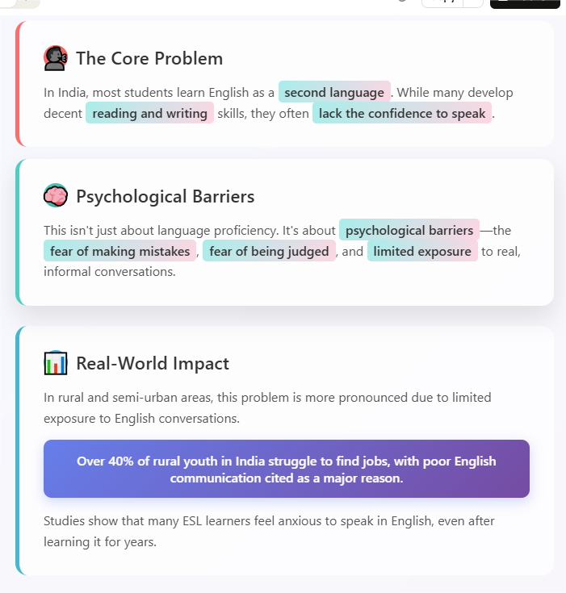
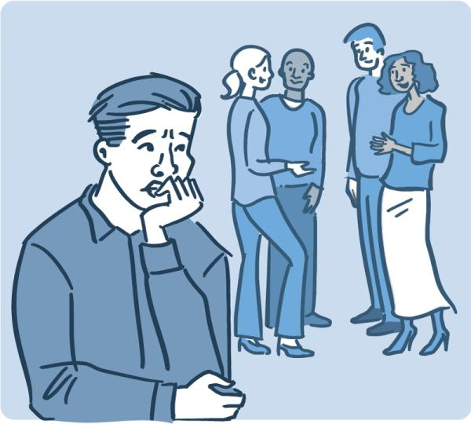
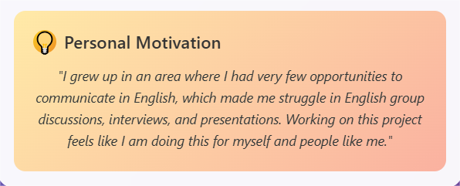
The Broader Problem
Notes:
We will start by understanding the problem,
In India, most students learn English as a second language.
While many develop decent reading and writing skills, they often lack the confidence to speak
this is not just about language proficiency. It’s about psychological barriers—the fear of making mistakes, fear of being judged.
In rural and semi-urban areas, this problem is more.
Due to limited exposure to English conversations, students often don’t get enough opportunities to develop their speaking skills.
Recent studies show that over 40% of rural youth in India struggle to find jobs, with poor English communication cited as a major reason.
Also some studies show that many ESL learners feel anxious to speak in English, even after learning it for years.
My personal experiences with english speaking is same, which motivates me to work on this project

Slide 3
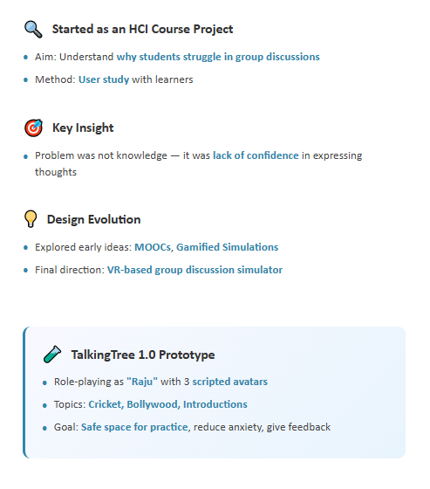

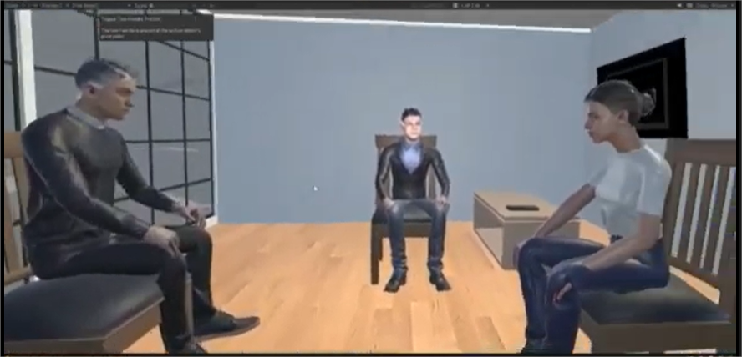
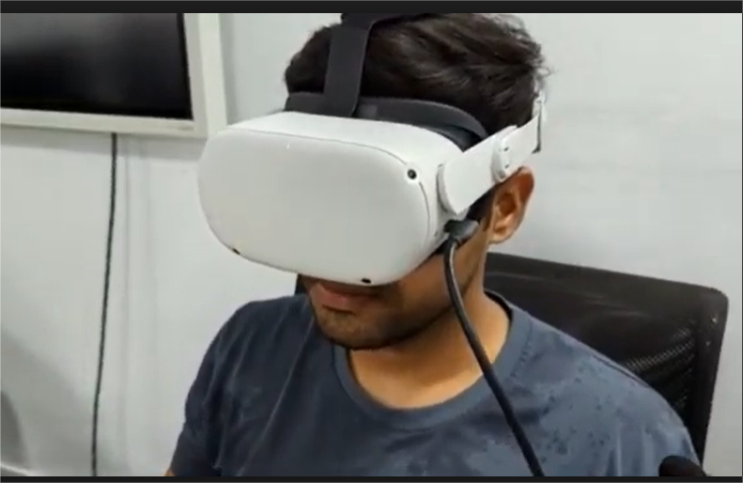
Notes:
The idea of this project began as a HCI Course Project. Our team wanted to understand why students struggled in group discussions.
We conducted a user study,
from that we understood most learners didn’t lack knowledge, they lacked confidence in expressing their thoughts.
To address this we designed a VR-based group discussion simulator.
In this version, users has to take part in informal group discussions, alongside three scripted avatars.

Slide 4
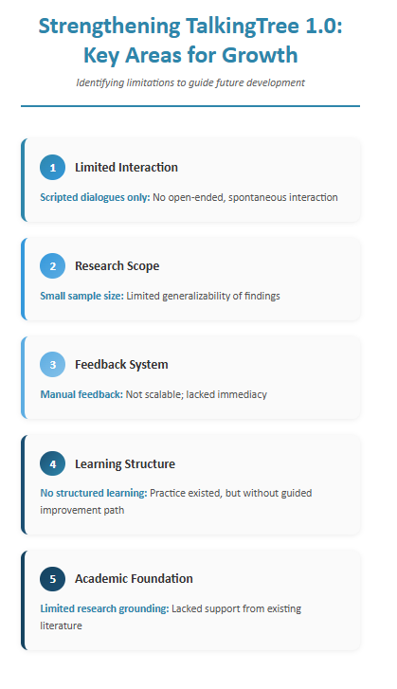
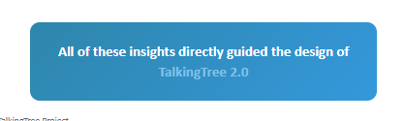
Notes:
After developing and evaluating It, There was several opportunities for improvement.
The system used scripted dialogues, so there is opportunity to bring in dynamic, AI-driven conversations.
We also worked with a small sample size, So need more systematic evaluation.
The feedback process was manual, There could be automated feedback.
platform focuses mainly on practice, So, there was potential to add a learning component..
All of these insights directly guided the design of next version.

Slide 5
Literature Review

Slide 6
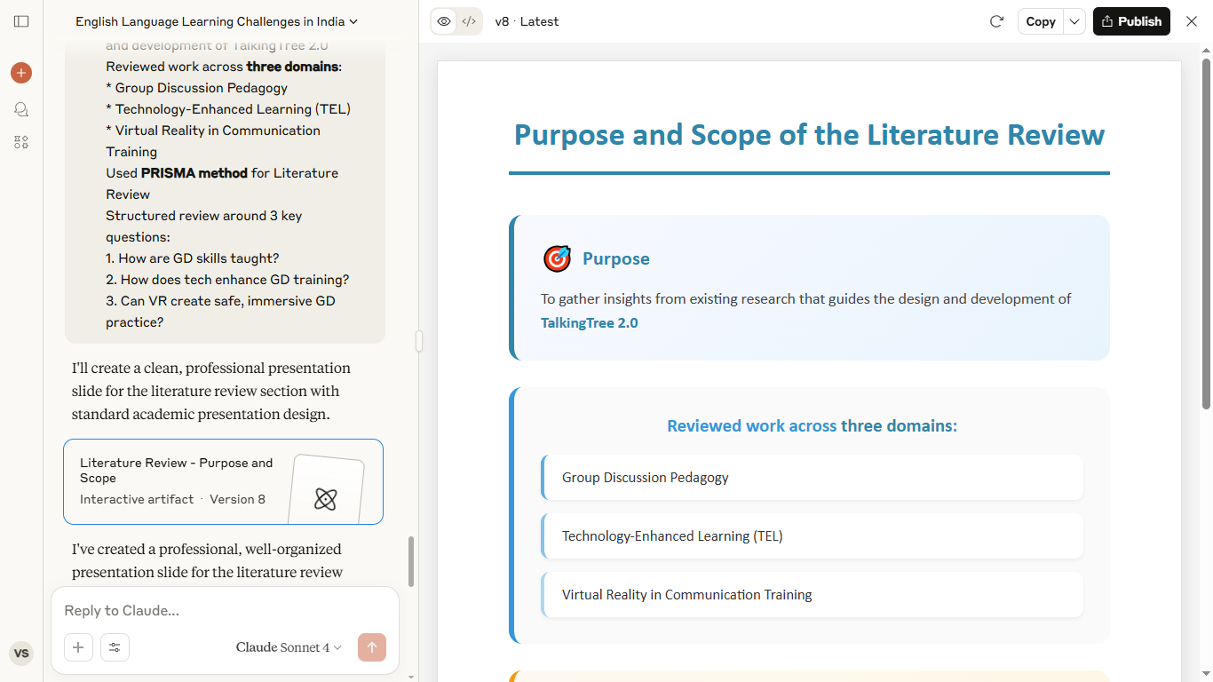
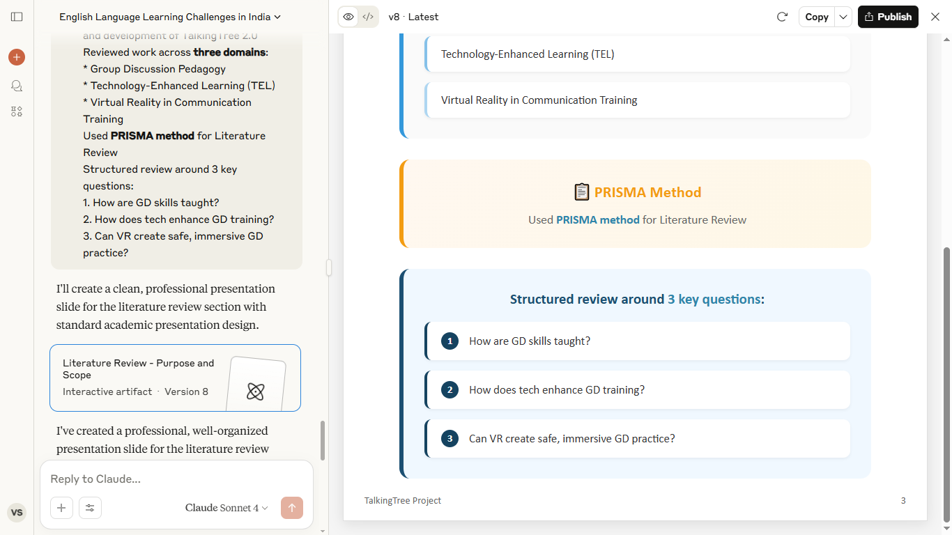
Notes:
"To design next version I called it TalkingTree 2.0, I began with literature review
I explored research across three domains with research questions:
How group discussion skills can be effectively practiced?
How technology ,can enhance the experience of group discussion?
How Virtual Reality (VR) create supportive environments for it?
:

Slide 7
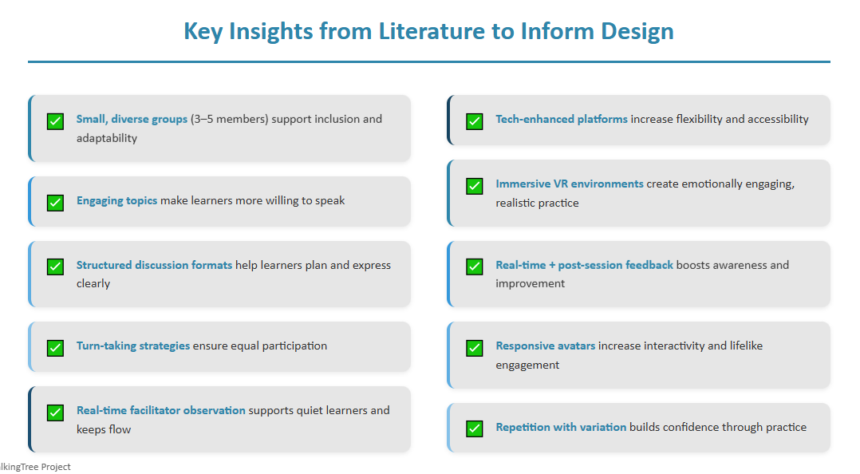
Notes:
“These are some of the key insights from the literature that shaped the design of next version of intervention.
For example, small groups of 3–5 with diverse members promoted inclusion and adaptability. And structured discussion formats helped learners plan what to say and stay more engaged.
Apart from these, prior research also highlighted that using relevant topics, responsive avatars, immersive VR, and real-time feedback made conversations feel more natural and boosted learner confidence.
However, there were still gaps. Most tools relied on scripted dialogues, lacked real-time personalization, and needed constant manual facilitation — which makes them less scalable or flexible.
These insights and gaps directly influenced how we designed TalkingTree 2.0.”

Slide 8
Intervention

Slide 9
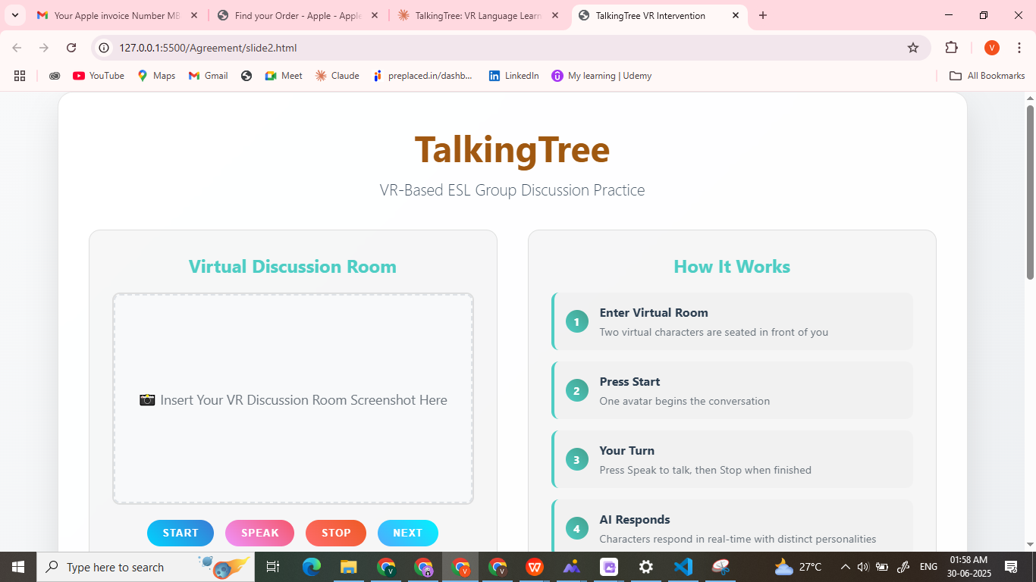
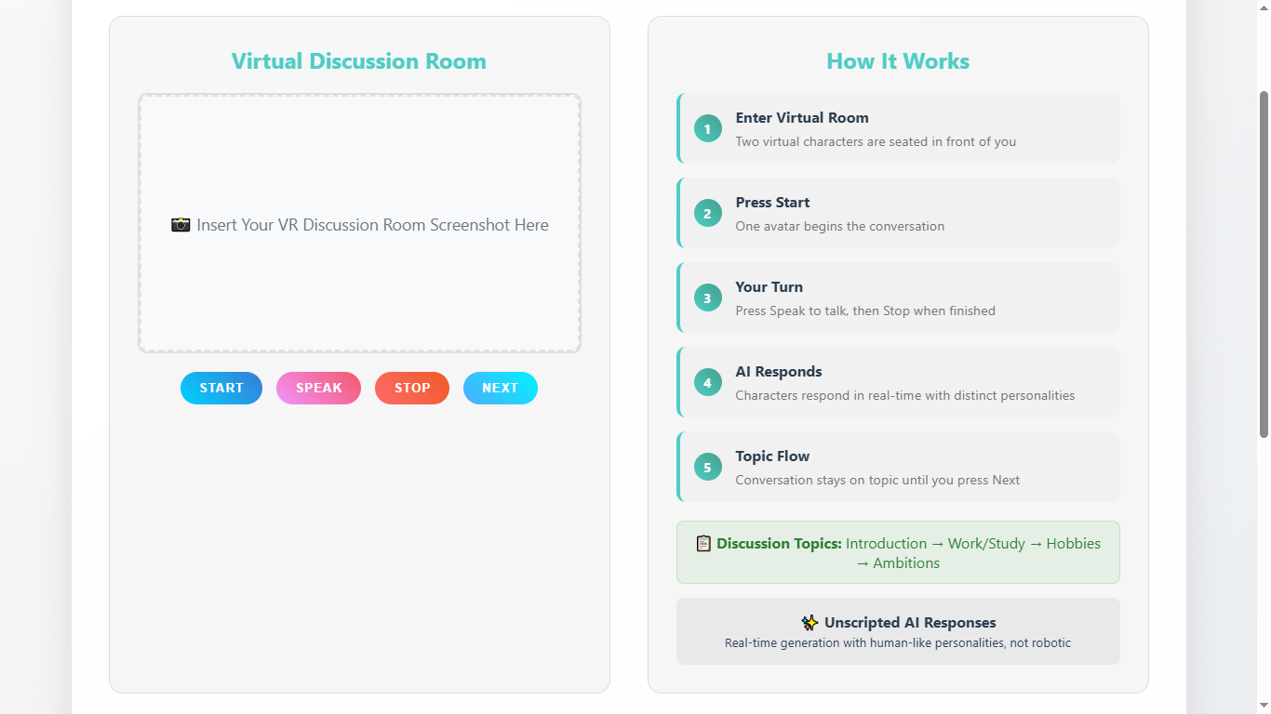
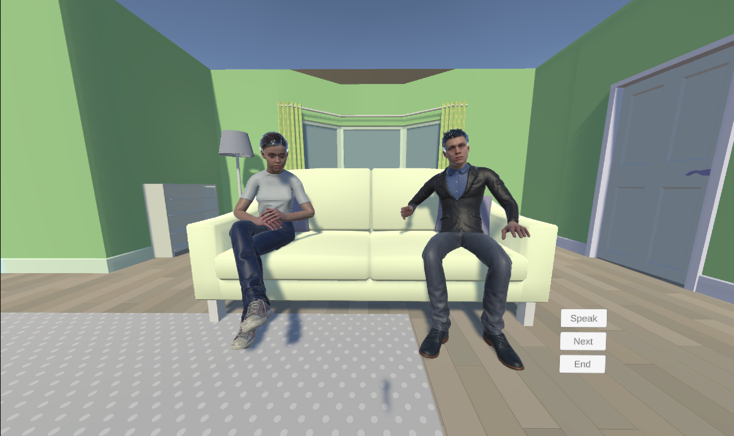
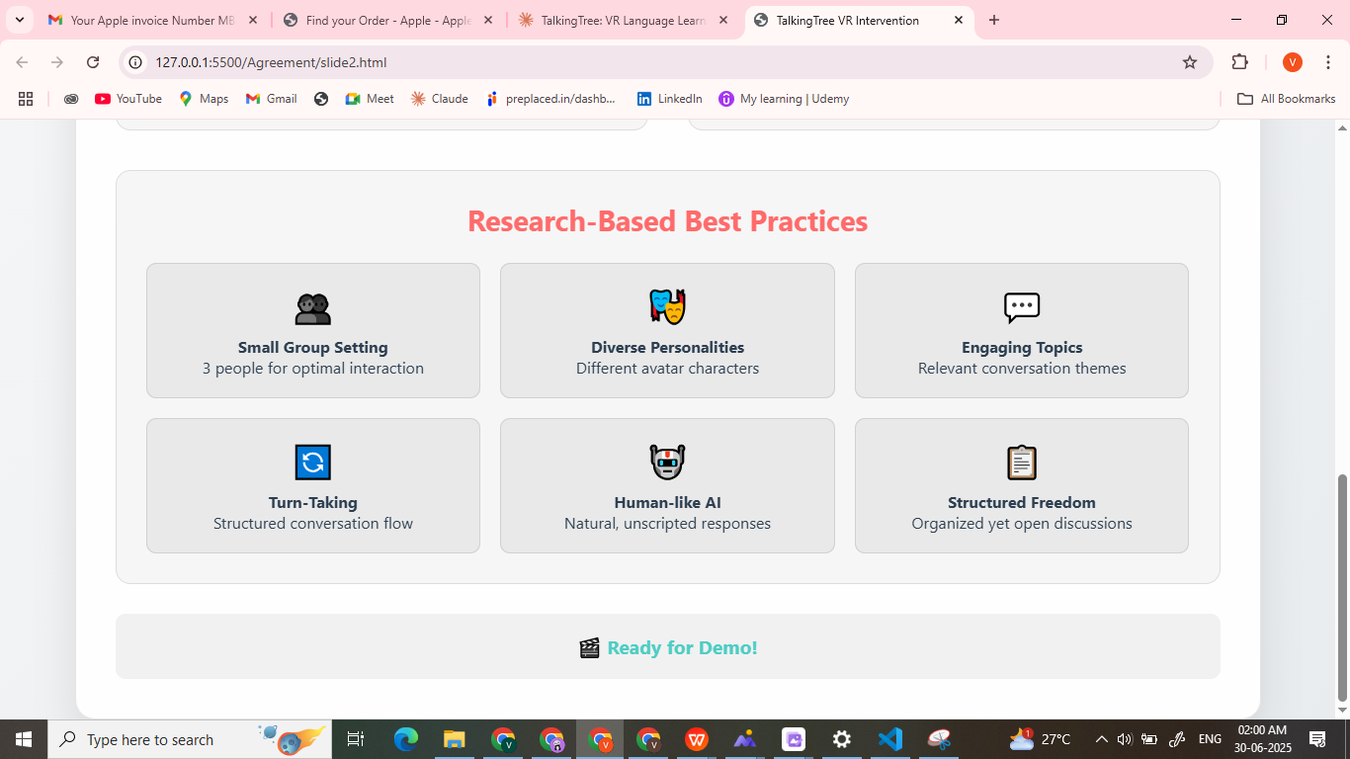
Notes:
The next Version, That designed and developed looks like this as in picture I will show demo also. I will tell what is there and how it works.
Its a VR Based intervention
When a user wears headset and enters the virtual discussion room, they saw two virtual characters seated in front of them.
User has to press Start button, then one of the avatars begins the conversation
When its user’s turn to speak, the user press the Speak button, and When speech finished, press Stop,
based on what user said, one of the character responds.
These responses from characters are not scripted. They generated in real time using AI.
Each avatar has a distinct personality and responds like a real person, not like a robot.
The discussion is structured into familiar topics — Introduction, What they do (Work/Study), Hobbies, and Ambitions.
The conversation between them stays within a topic until the user presses Next,
If you notice, this design reflects research-based best practices:
Small group setting (3 people)
Diverse peers with different personalities
Relevant and engaging topics
Structured but open conversation
Turn-taking
And unscripted, human-like avatar responses
We will see a short demo of this. To save time, Video is Speeden up, So conversation looks fast

Slide 10
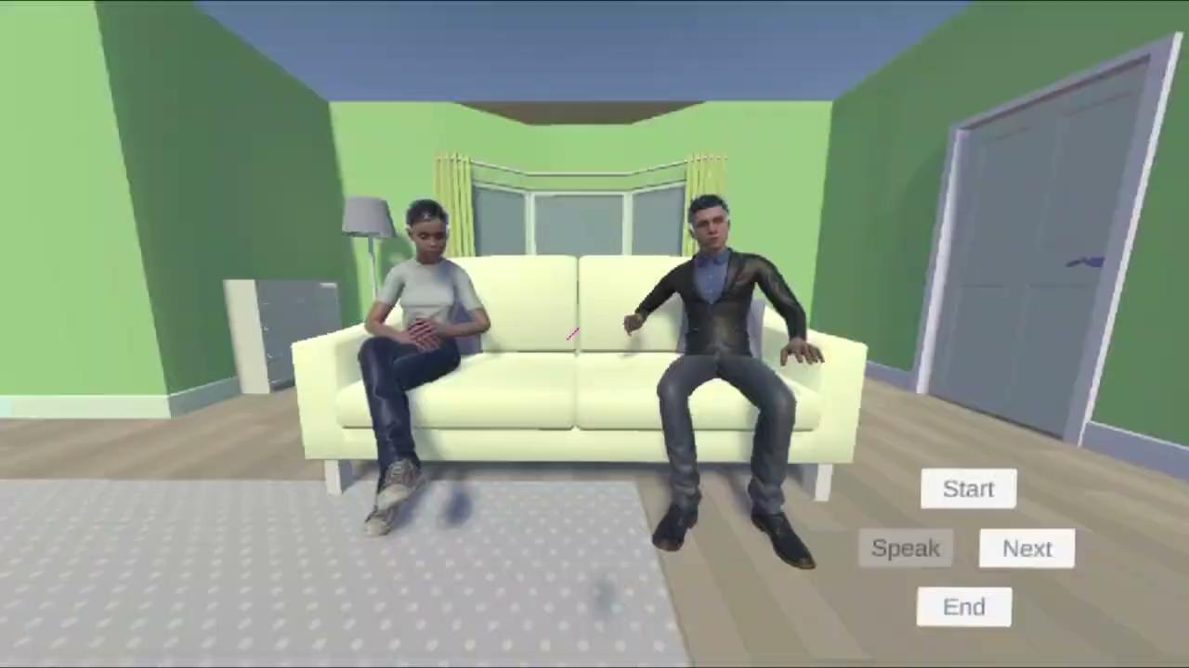
Notes:
Demo 1

Slide 11
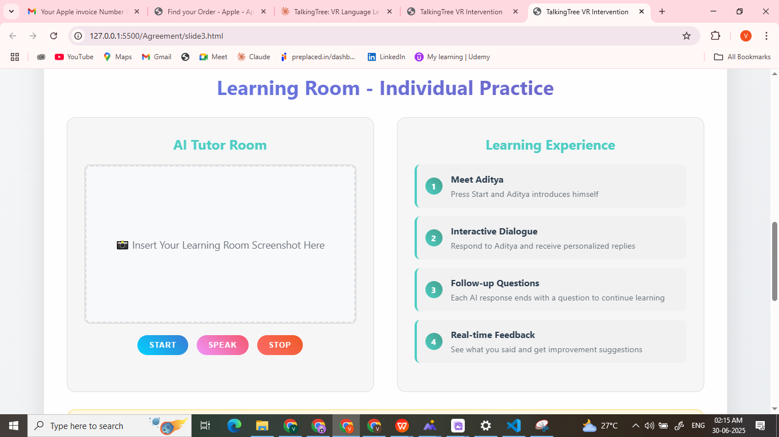
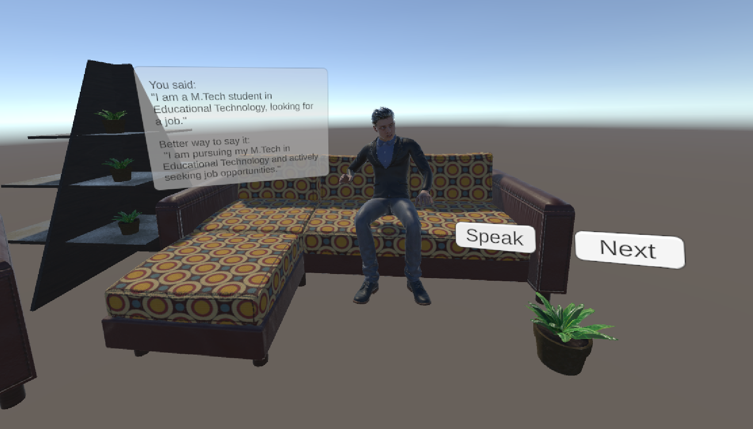
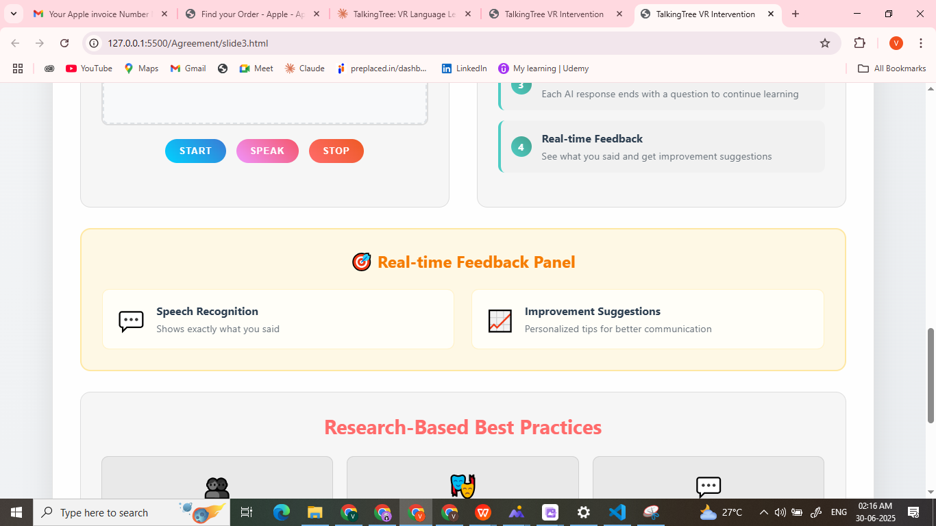
Notes:
The intervention also includes another virtual room designed for learning Purpose.
In this space, the user interacts with one AI character.
When the user presses the Start button, character introduces himself
When user responds, this character gives a reply based on what the user said, and at the end of each response, asks a follow-up question.
A key feature here is the real-time feedback panel,:
It shows what user says - for ex. Sagar is my name, Karad is my city.
and what can be improved. - My name is sagar and I am from Karad.
Lets see of demo of this also.

Slide 12
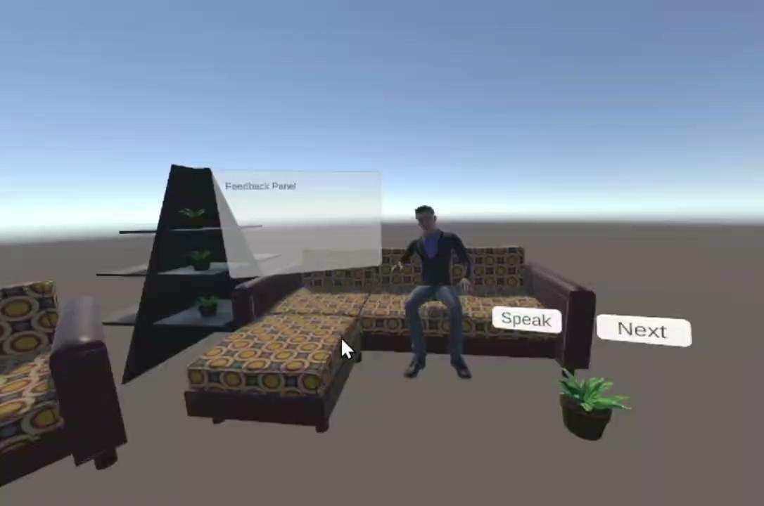
Notes:
Demo 2 So this is about Intervention. TalkingTree 2.0 is built in Unity 3D, programmed in C#.

Slide 13
Research Study

Slide 14
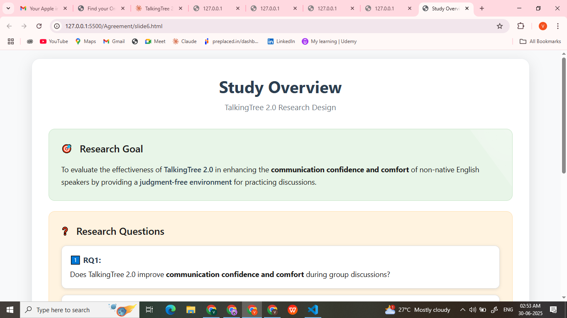
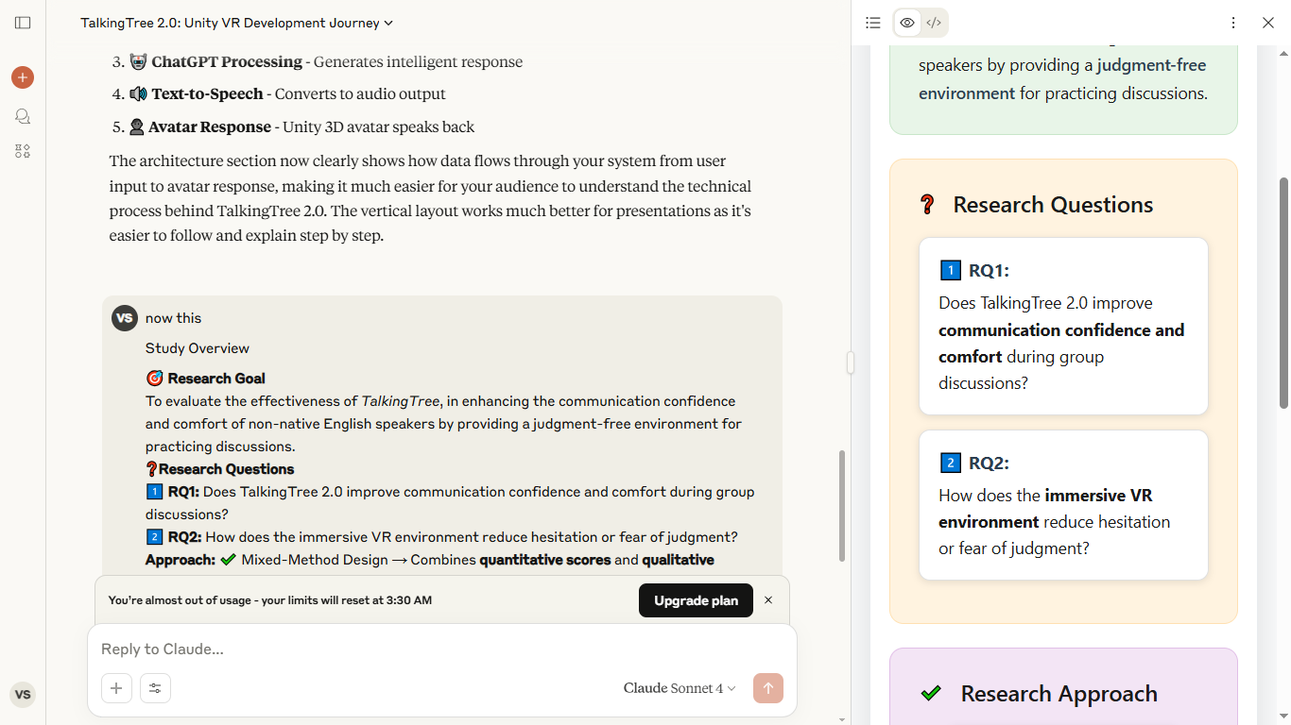
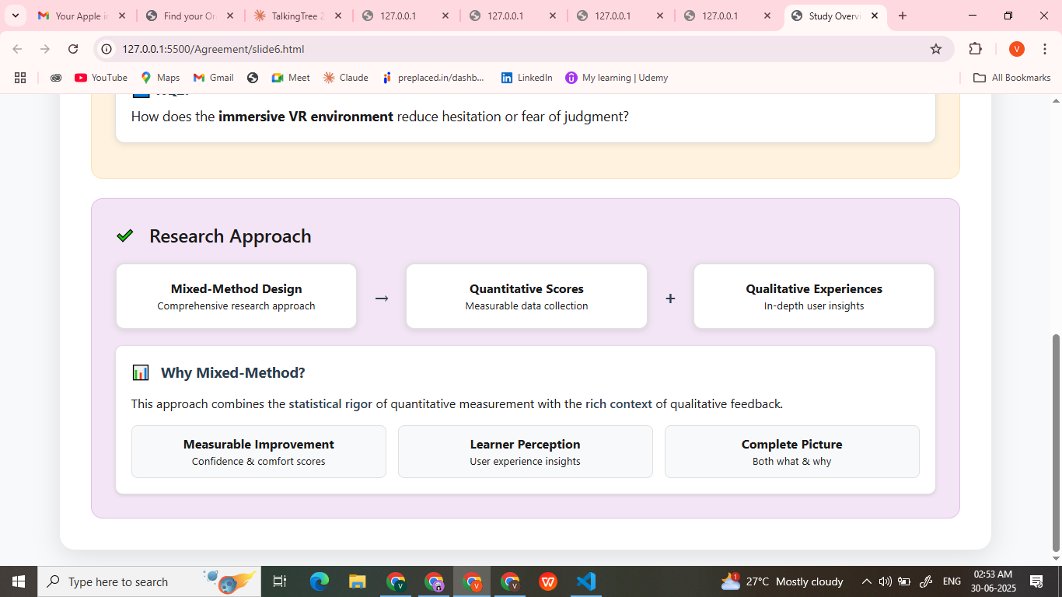
Notes:
After developing the intervention, to understand, does this actually helpful for learners, I conducted study.
The two research questions are 1. Does this intervention improves communication confidence and comfort during group discussion.
2. How does VR Environment reduces hesitation and fear of judgement
For conducting study I have used Mixed-Method Approach.

Slide 15
Constructs and Their Measurable Variables
Construct
Code | Variable Description
CON-1 | Expressing thoughts clearly
CON-2 | Speaking calmly and composed
CON-3 | Sharing ideas proactively — even without being asked
CON-4 | Asking questions — for clarification or follow-up
CON-5 | Showing motivation to participate
CON-6 | Acknowledging or building on others' responses
COM-1 | Feeling relaxed and at ease while speaking
COM-2 | Comfort in sharing personal thoughts or experiences
COM-3 | Using open body language during interaction
Communication Confidence Belief in one's ability to speak clearly and engage effectively in discussions (Parveen et al., 2023)
Communication Comfort Emotional ease, openness, and psychological safety while speaking (Roongruang See et al., 2022)
Notes:
For Evaluating we focused on two constructs communication confidence and comfort.
These two constructs are especially relevant for ESL learners,
"To measure these two constructs, we broke them down into nine observable variables — six for communication confidence, and three for communication comfort.
These variables were measured using two tools: self-report questionnaire to capture learners’ internal perceptions, and a Assessment rubric to assess observed communication behaviors.

Slide 16
Self Report Questionnaire
Code | Self Report Questions | Scale
CON-1 | During the discussion, were you able to express your thoughts clearly and effectively? | ⚪⚪⚪⚪⚪⚪⚪
CON-2 | While contributing to the discussion, did you feel calm and composed rather than rushed or anxious? | ⚪⚪⚪⚪⚪⚪⚪
CON-3 | Did you feel comfortable sharing your ideas, even when you weren’t directly asked? | ⚪⚪⚪⚪⚪⚪⚪
CON-4 | Did you confidently ask questions to clarify points or to continue the conversation? | ⚪⚪⚪⚪⚪⚪⚪
CON-5 | Did you feel motivated to actively participate and share your thoughts during the discussion? | ⚪⚪⚪⚪⚪⚪⚪
CON-6 | Did you acknowledge others' responses by agreeing, nodding, or adding to their points? | ⚪⚪⚪⚪⚪⚪⚪
COM-1 | Did you feel relaxed and at ease while participating in the discussion? | ⚪⚪⚪⚪⚪⚪⚪
COM-2 | Did you feel comfortable sharing personal experiences or stories during the discussion? | ⚪⚪⚪⚪⚪⚪⚪
COM-3 | Did you use open body language such as relaxed posture, eye contact, and natural gestures? | ⚪⚪⚪⚪⚪⚪⚪
Notes:
The self report questionnaire included 9 items, each corresponding to one of the finalized variables. Each item was rated on a 7-point Likert scale, ranging from 1 (Not at all) to 7 (Yes, absolutely).

Slide 17
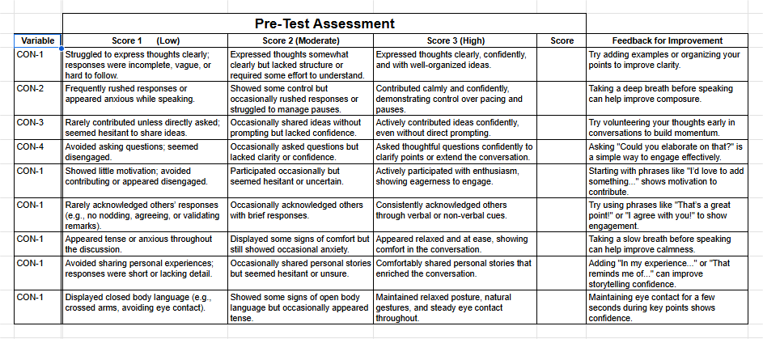
Assessment Rubric
Notes:
The assessment rubric also include 9 variables that matched the questionnaire items for consistent, parallel measurement. Each variable was rated on a 3-point scale:
These Instruments are designed by researcher based on existing literature, validated through two EdTech Researchers. And pilot tested with small group of learners.

Slide 18
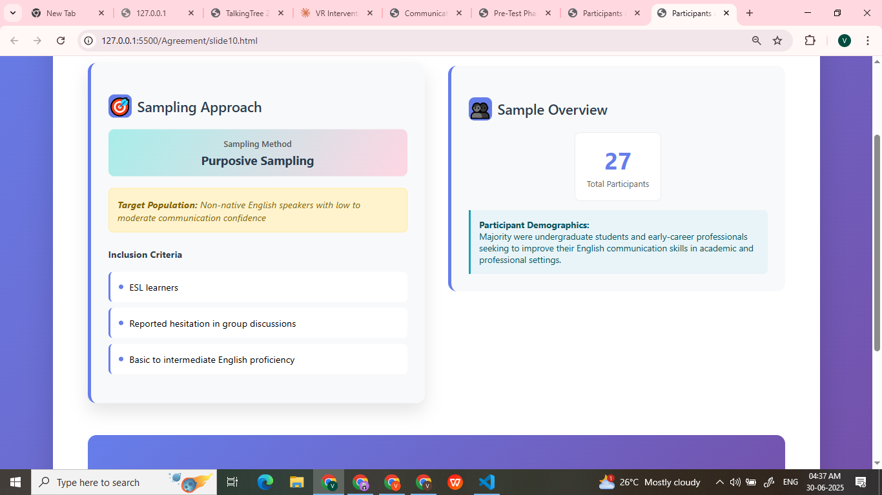
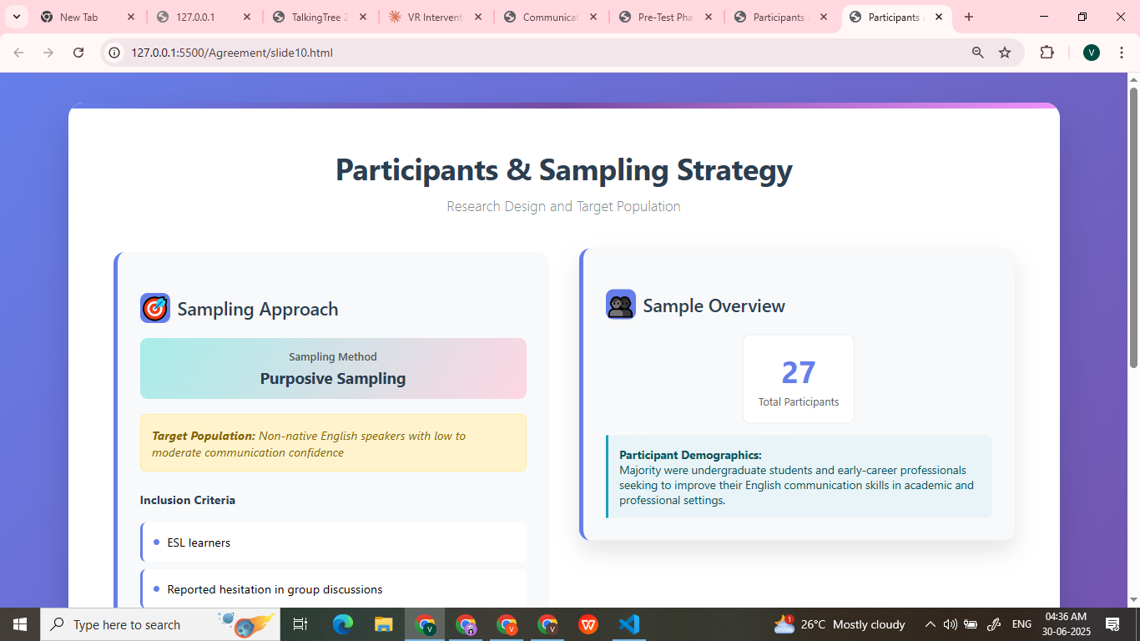
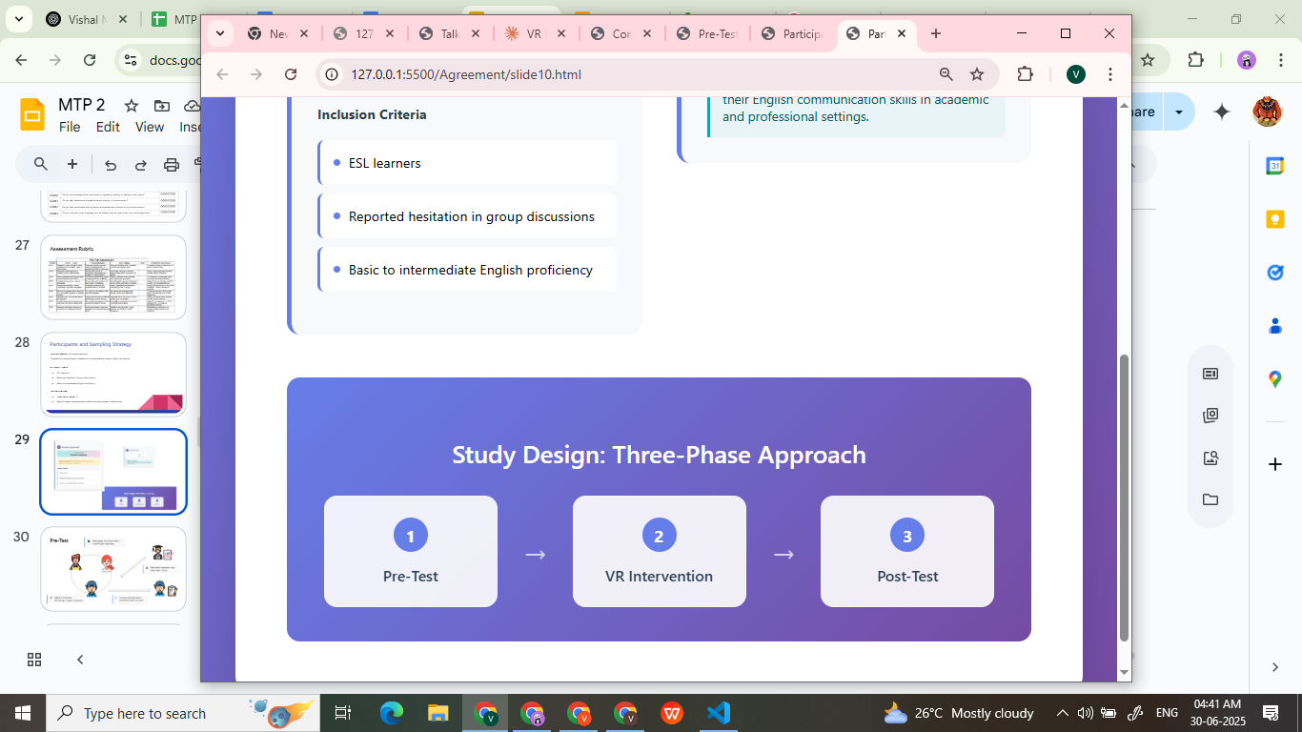
Participants & Sampling Strategy
Research Design and Target Population
Notes:
For this study we needed a participant who is non-native English speaker, who struggles in communication confidence in english.
So, to recruit the participants I used purposive sampling - and selected those, who self-reported basic to intermediate english proficiency but lacked confidence in speaking.
Total Participants were 27,
The study was conducted in three phases: a pre-test, the intervention and a post-test.

Slide 19
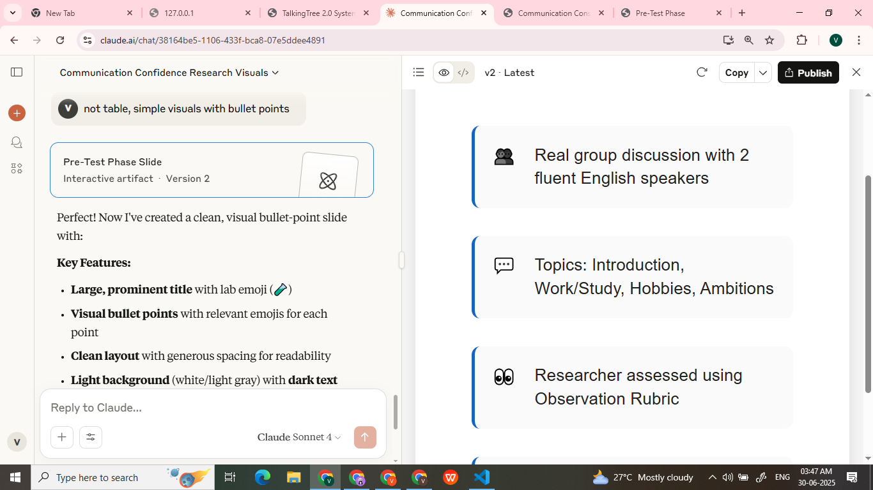






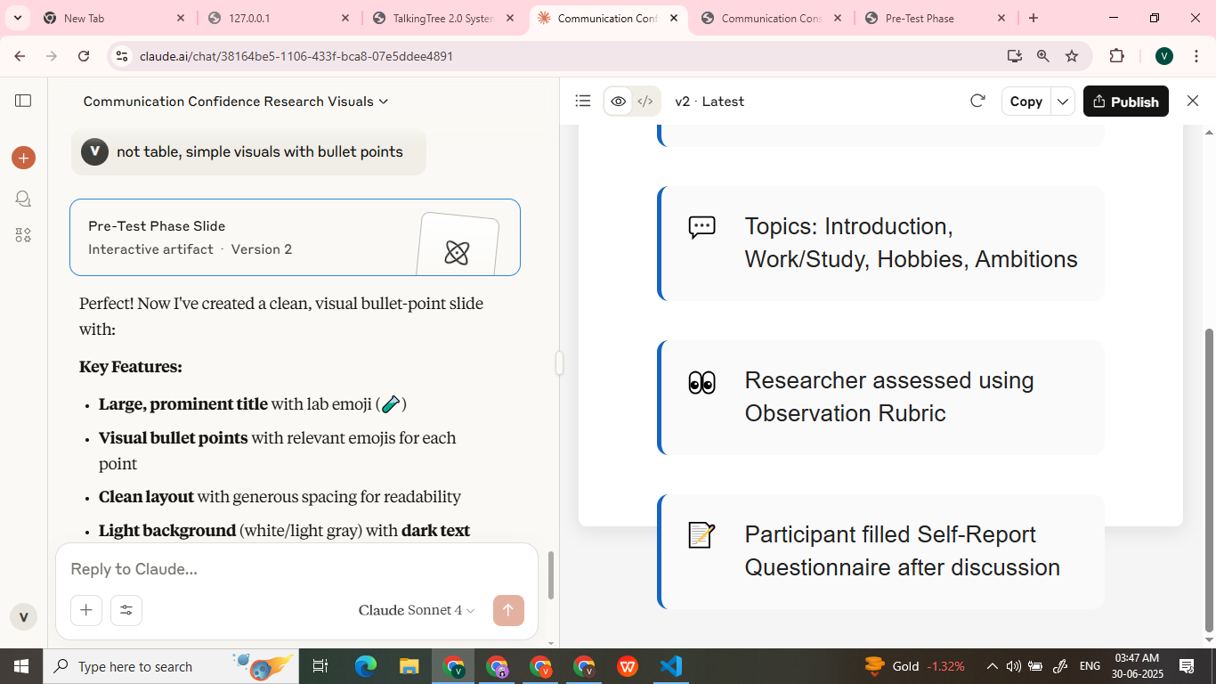
Pre-Test
Notes:
In the pre-test phase, each participant engaged in a real group discussion with two fluent English speakers.
discussion is based on the relevant topics like, Introduction, what they work/study, Interests, Ambitions.
While discussion one researcher is evaluating participant using observation Rubric..that How user is performing and give scores based on that
After the discussion, Participant fills self report questionnaire. Which is the Perception of how they performed.

Slide 20
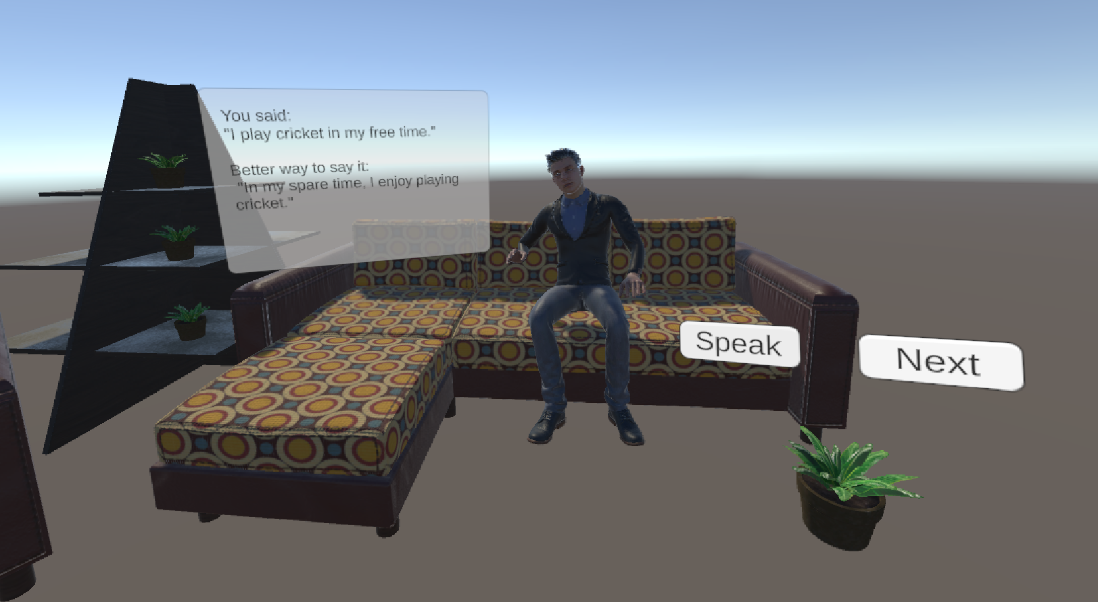
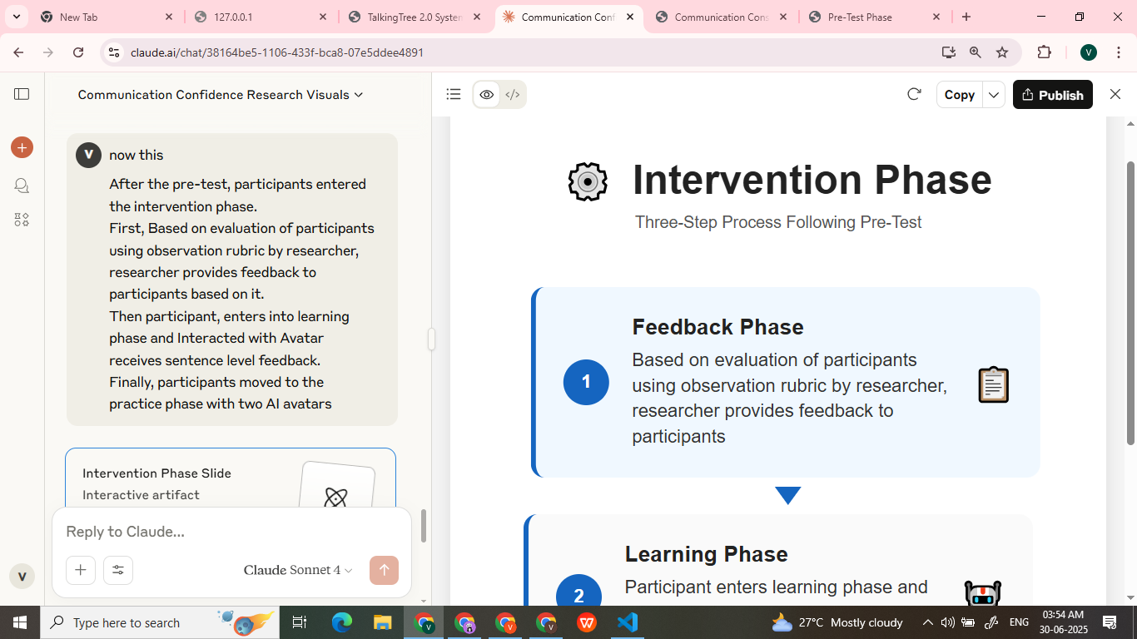
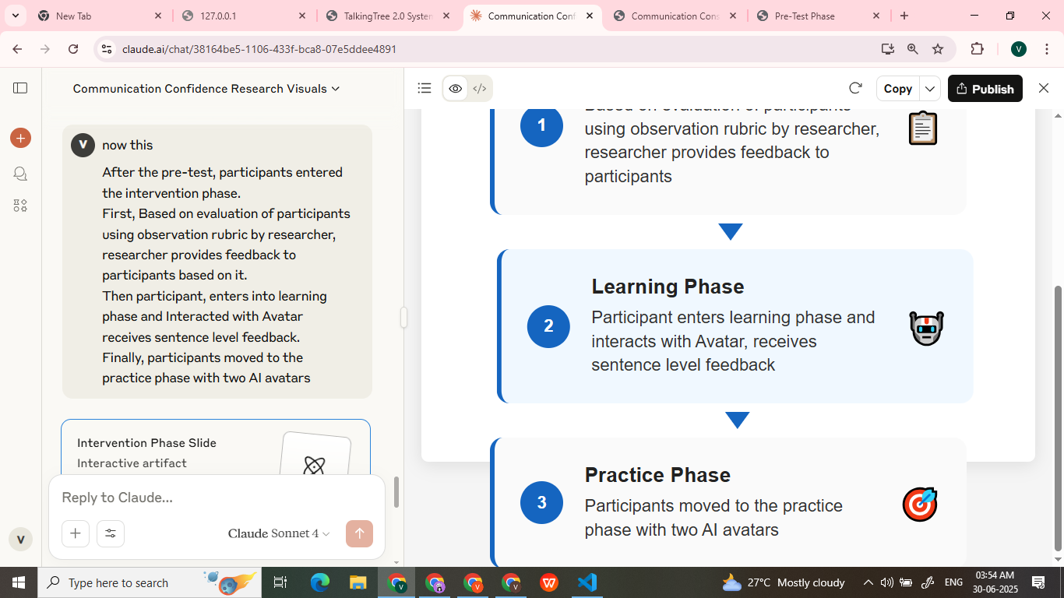
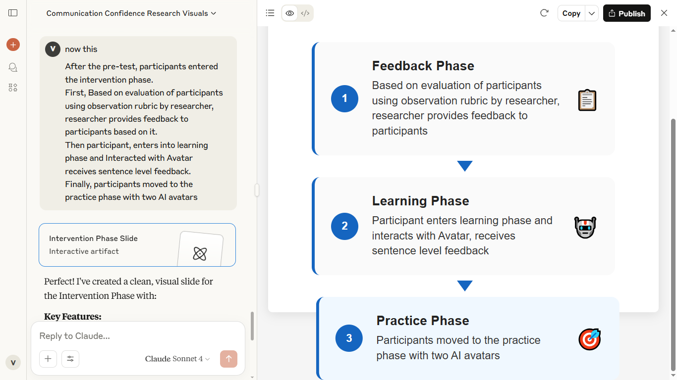
Intervention
01
02
03
Notes:
After the pre-test, participants entered the intervention phase.
First, Based on evaluation of participants using observation rubric by researcher, researcher provides feedback to participants.
In rubric for low score under each item there is feedback associated with it.
Then participant, enters into learning phase and Interacted with Avatar, with follow up questions of avatar, user takes his time, frame the answer and responds, and on his response He receives sentence level feedback.
Finally, participants moved to the practice phase with two AI avatars,

Slide 21
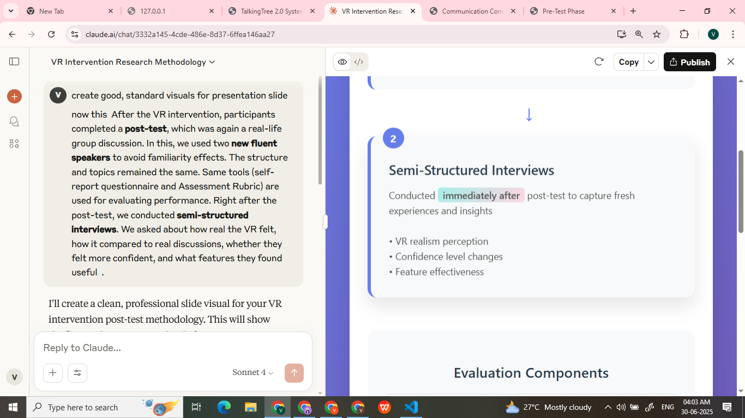
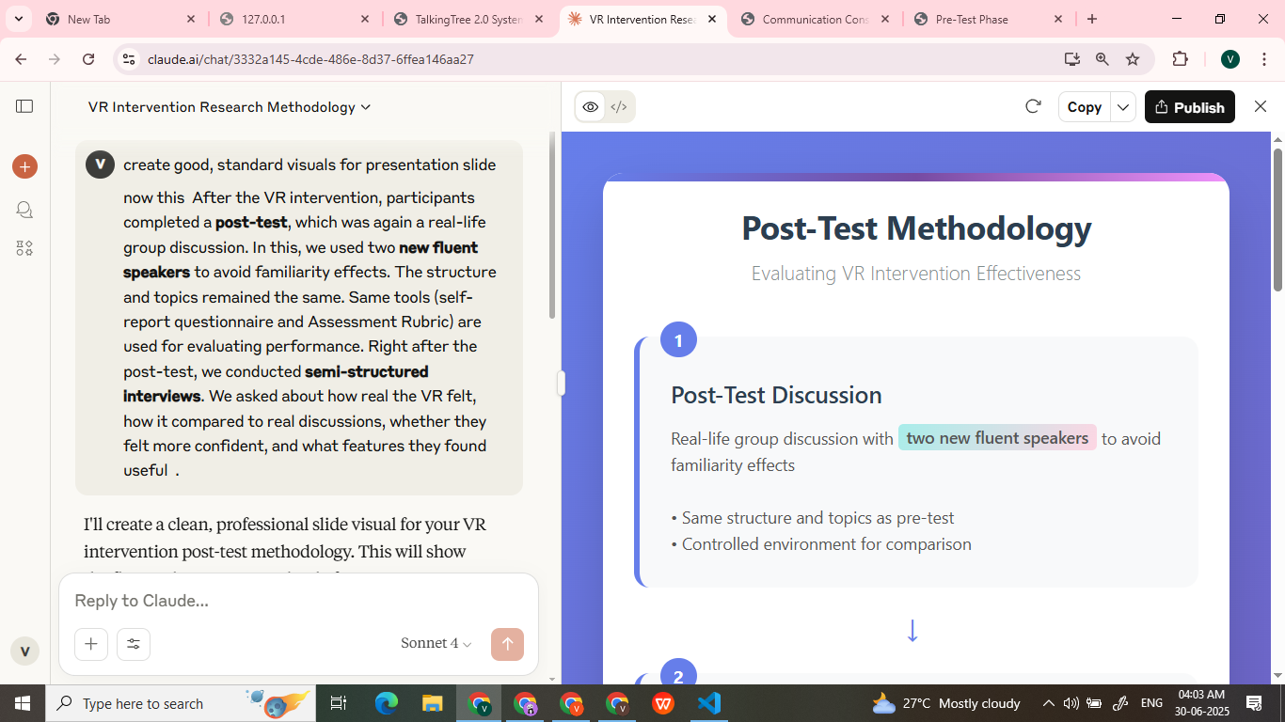


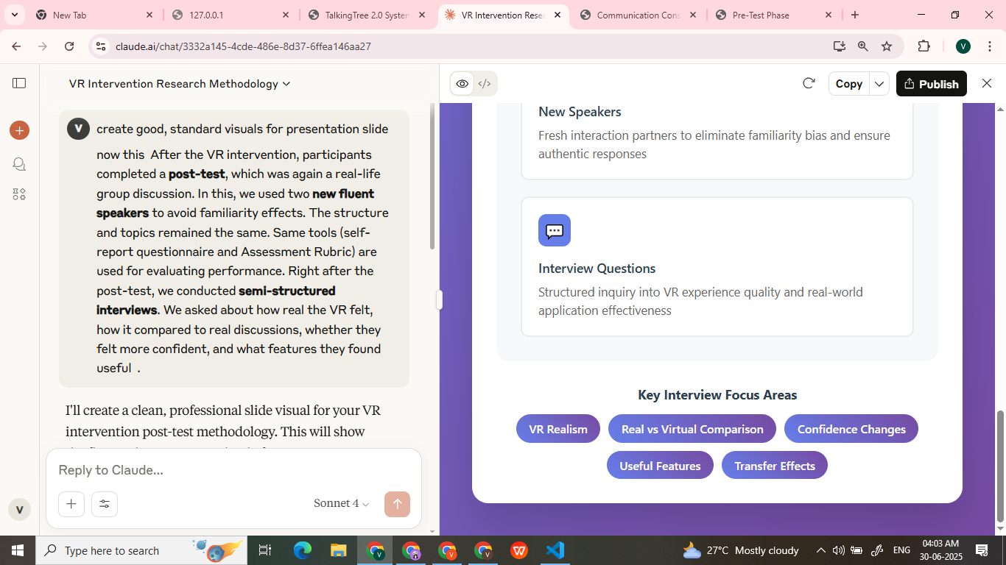
Post-Test
Notes:
After the VR intervention, participants completes a post-test, which was again a real-life group discussion.
In this, we user interacted with two new fluent speakers to avoid familiarity effects.
The structure and topics remained the same.
Same tools (self-report questionnaire and Assessment Rubric) are used for evaluating performance.
Right after the post-test, we conducted semi-structured interviews.
We asked about how real the VR felt, how it compared to real discussions, whether they felt more confident, and what features they found useful .

Slide 22
Data Analysis & Findings

Slide 23

Data Analysis
Quantitative Analysis
Self Report data (Pre + Post)
01
Data Preparation
Descriptive Analysis
Inferential Analysis
Rubric Data (Pre + Post)
Qualitative Analysis
Semi-Structured Interview data
02
Thematic Analysis
Notes:
"After conducting the study, the next is data Analysis.
Data That we collected through self report forms and assessment rubrics is used for descriptive and inferential analysis.
And with the Interview data, I did Thematic Analysis.

Slide 24
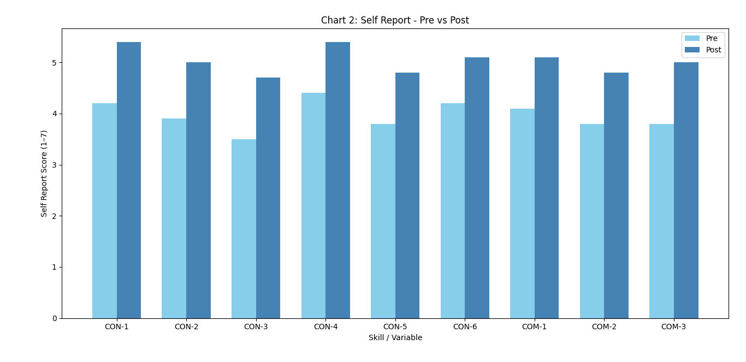
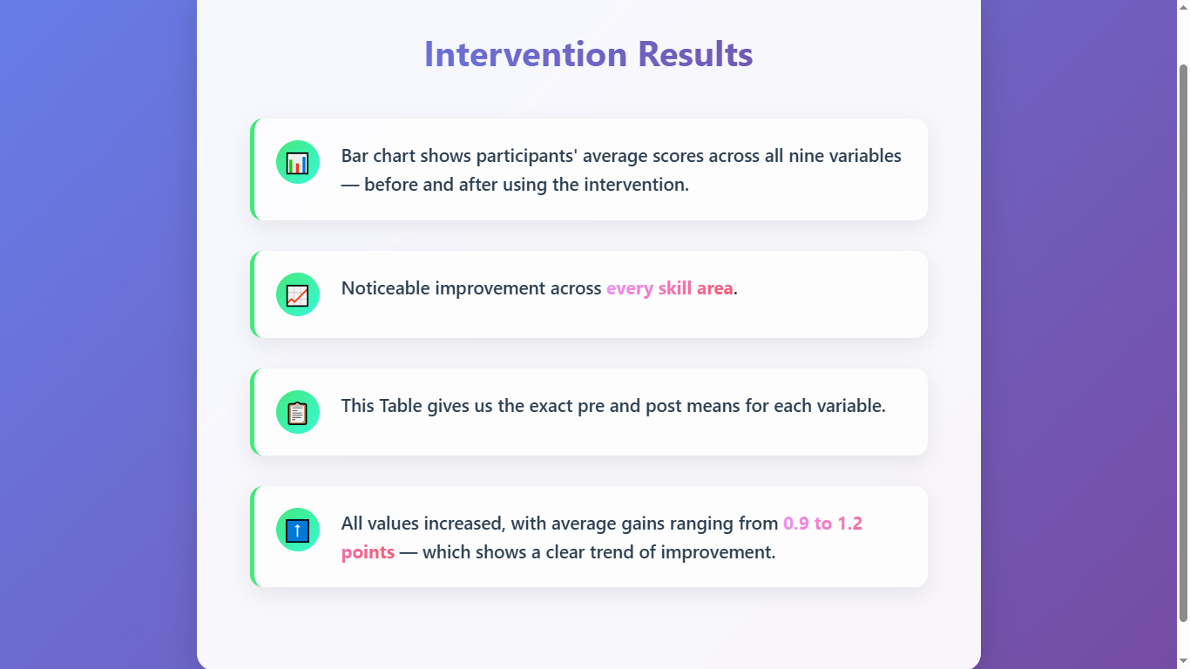
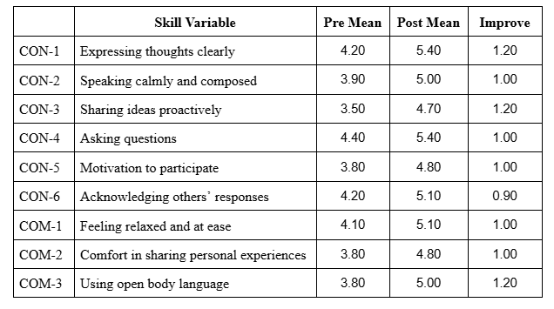
Descriptive Analysis - Self report
Notes:
This is descriptive analysis of the self-report scores. This bar chart shows participants' average scores across all nine variables — before and after using the intervention.
you can see, there's a noticeable improvement across every skill area.
This table on the right gives us the exact pre and post means for each variable. All values increased, with average gains ranging from 0.9 to 1.2 — which shows a clear trend of improvement.

Slide 25
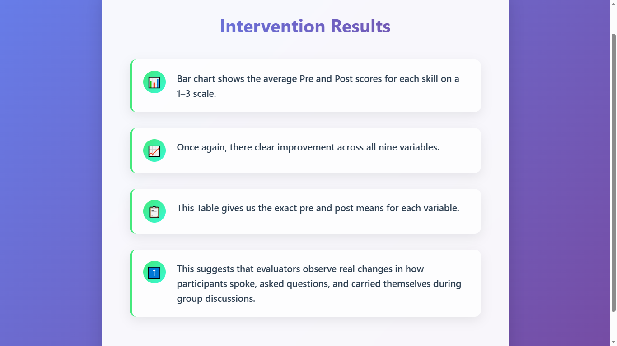
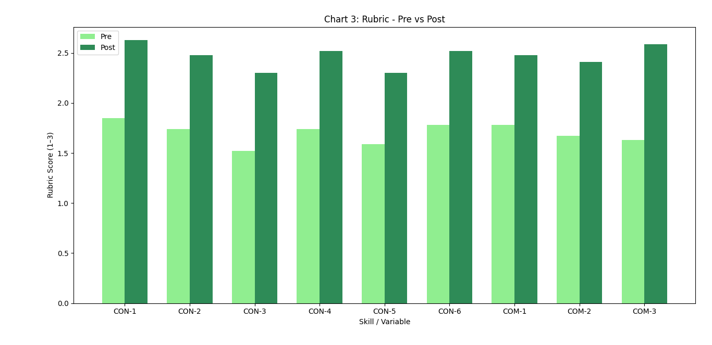
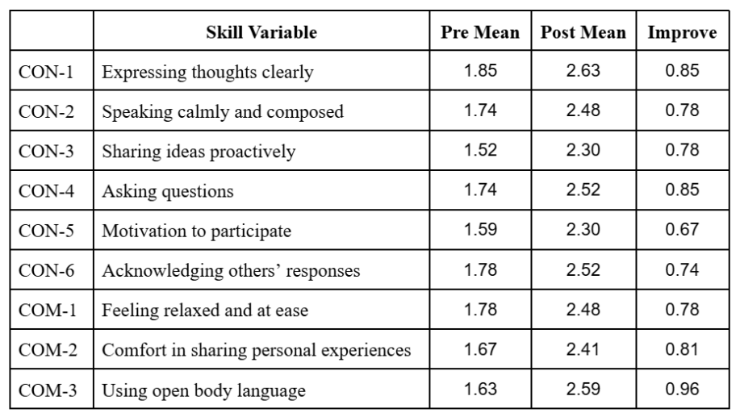
Descriptive Analysis - Assessment Rubric
Notes:
This is analysis of scores given by expert evaluators using a assessment rubric. This chart shows the average Pre and Post scores for each skill on a 1–3 scale.
Once again, there clear improvement across all nine variables.
This suggests that evaluators observe real changes in how participants spoke, asked questions, and carried themselves during group discussions.”

Slide 26
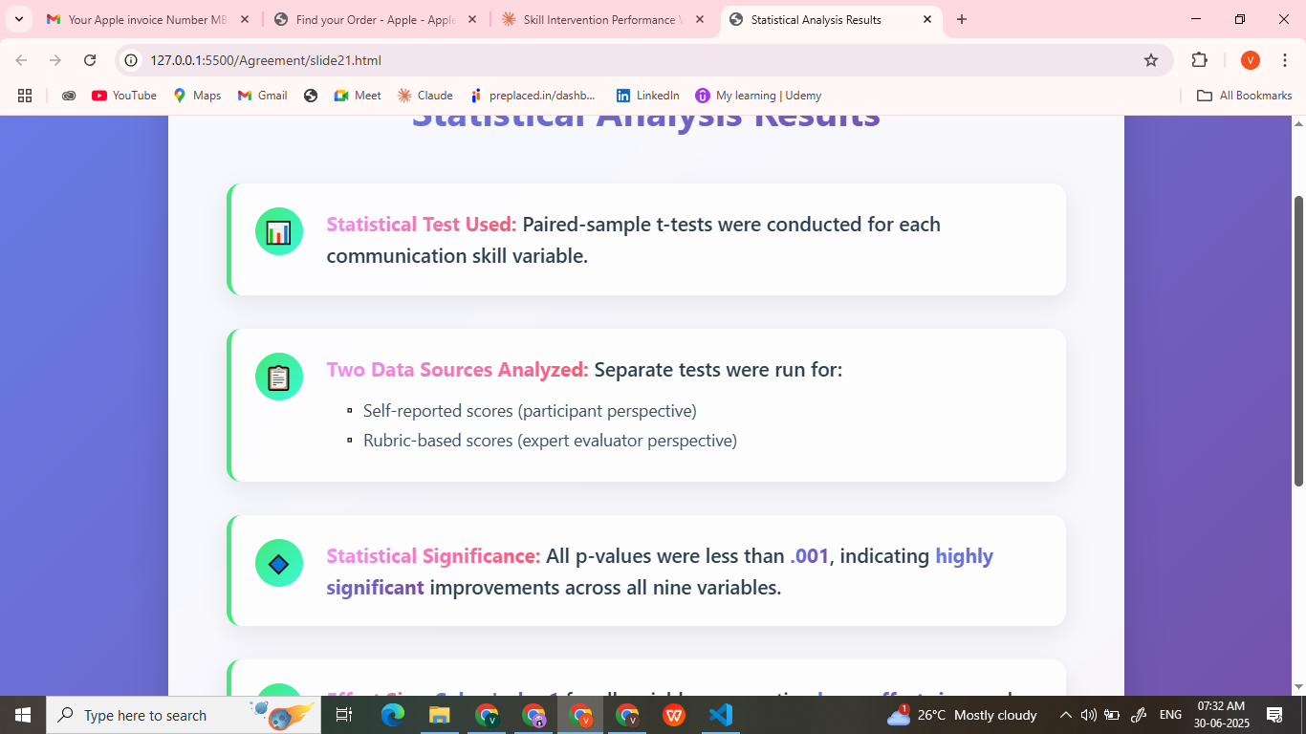
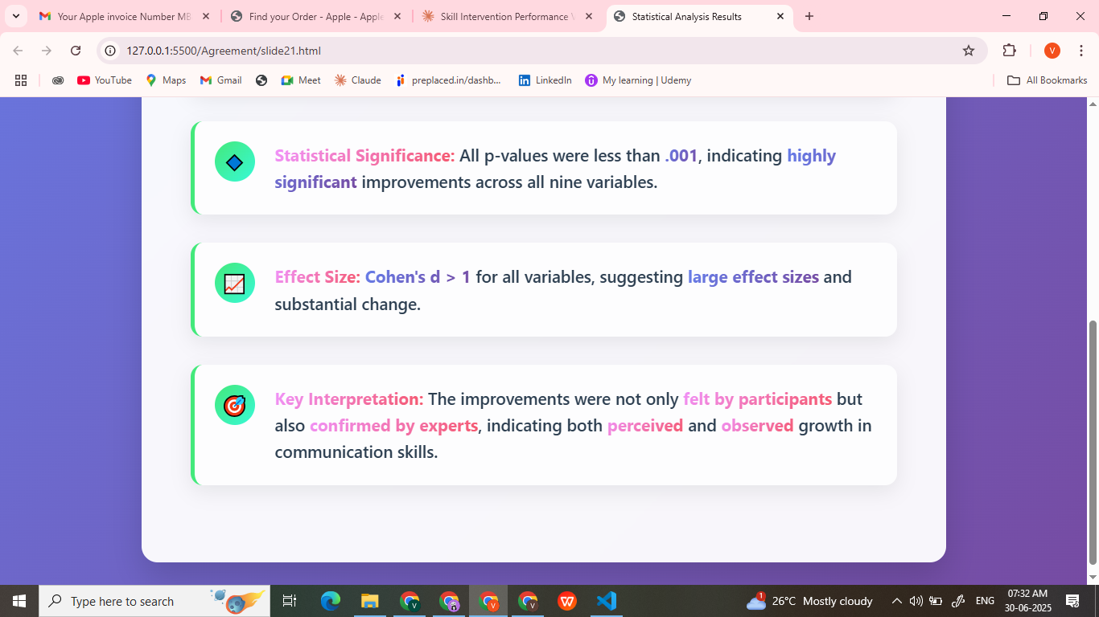
Inferential Analysis
Table :Paired Samples t-Test and Effect Sizes – Rubric
Variable | t-statistics | p-value | Cohen’s d
CON-1 | 12.23 | <.001 | 2.35
CON-2 | 9.54 | <.001 | 1.84
CON-3 | 9.54 | <.001 | 1.84
CON-4 | 9.54 | <.001 | 1.84
CON-5 | 7.21 | <.001 | 1.39
CON-6 | 7.86 | <.001 | 1.51
COM-1 | 7.86 | <.001 | 1.51
COM-2 | 8.62 | <.001 | 1.66
COM-3 | 26.00 | <.001 | 5.00
Table :Paired Samples t-Test and Effect Sizes – Self-Report
Variable | t-statistics | p-value | Cohen’s d
CON-1 | 7.50 | <.001 | 1.44
CON-2 | 8.30 | <.001 | 1.60
CON-3 | 8.10 | <.001 | 1.57
CON-4 | 11.00 | <.001 | 2.08
CON-5 | 6.80 | <.001 | 1.28
CON-6 | 7.80 | <.001 | 1.50
COM-1 | 8.00 | <.001 | 1.54
COM-2 | 6.70 | <.001 | 1.28
COM-3 | 9.00 | <.001 | 1.77
Notes:
Now to understand whether these improvements were statistically significant or not.
I ran paired-sample t-tests for each variable — one set for self-reported scores (on the left) and another for Assessment rubric scores (on the right).
🔹 In both cases, p-values are less than .001 for all nine variables — meaning the improvements are statistically significant. 🔹 Cohen’s d values greater than 1, which indicates large effect sizes.
This also confirms that learners didn’t just feel more confident — it was also visible to expert evaluators.”

Slide 27
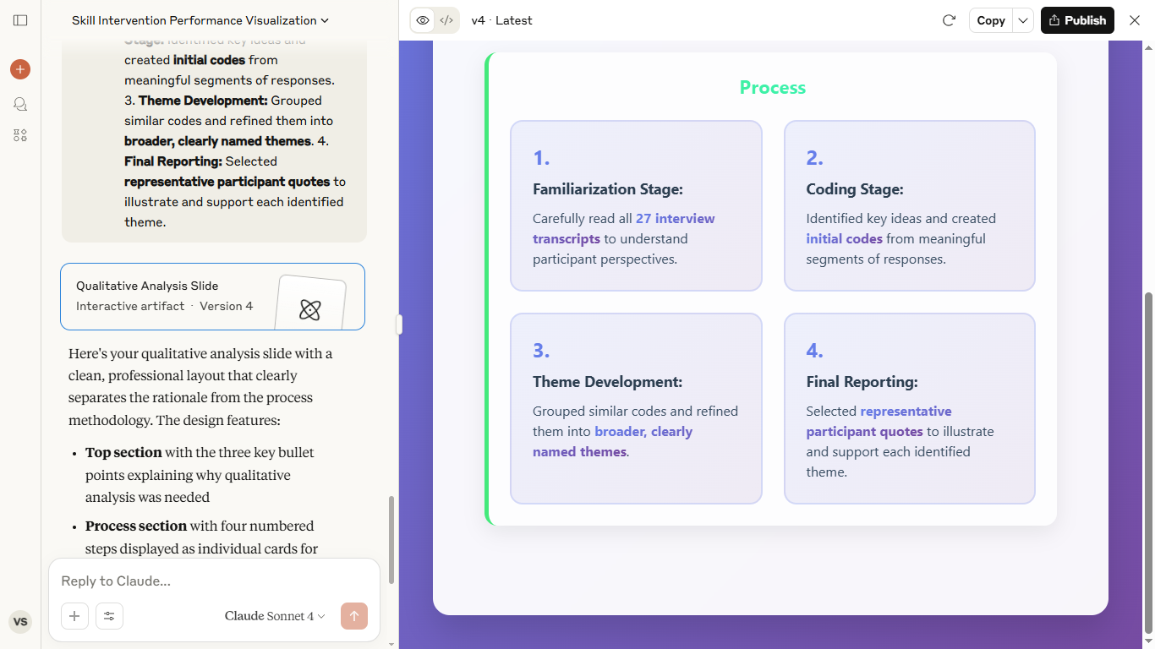
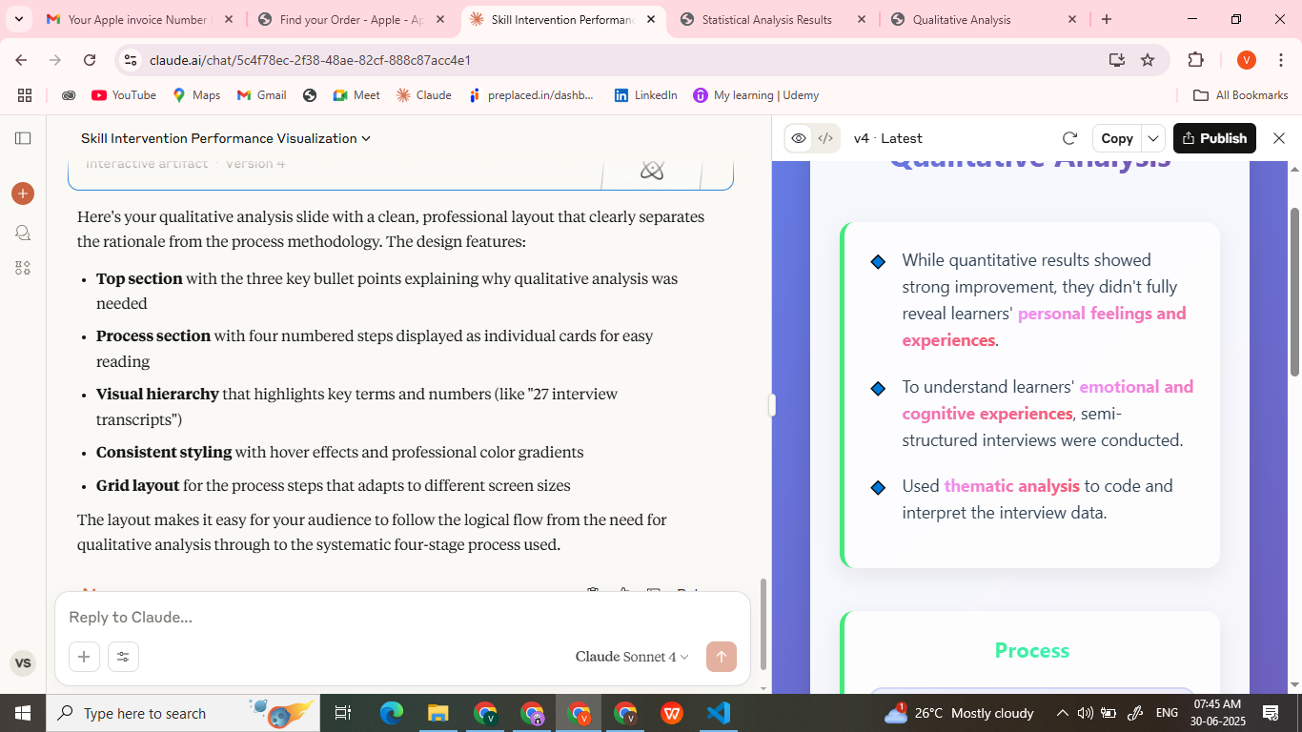
Quantitative Analysis
Notes:
quantitative results showed strong improvement, they didn’t fully capture how learners actually felt during the experience.
To understand how learners actually felt during the experience.
"I conducted a thematic analysis of the 27 interview transcripts. After familiarizing myself with the data, I coded key ideas, grouped similar codes into broader themes, and presented the findings using representative participant quotes."

Slide 28
Theme | Summary of Findings | Representative Quote
Comfort | Participants appreciated the absence of social judgment in the VR setting. VR reduced social pressure | “मी English मध्येfluent आहेअसंनाही... judgment जाणवत नव्हतं... pause घेऊन बोलूशकलो.” .“Classroom मध्येcorrection embarrassing वाटतो…इथे सहज accept केलं”
Confidence | Learners reported increased willingness to speak, even after errors. Learner felt growth through trial and feedback | “मी दोनदा चकलु ेपण पढचं ु उत्तर दिलं, थोडा Confidence आला मला..” “मी fluent झालोय असंनाही म्हणणार, पण मी बोलायला लागलोय.”
Feedback | Personalized verbal feedback, helped Learners understand their individual areas for improvement. real-time panel offered improved suggestions learners could reflect on. | “feedback… actually helpful वाटल्या” “clarity मिळाली… visually पाहिल्यामळु ेलक्षात राहिलं” “कोणी समोरून correction करण्यापेक्षा, panel मळु ेफक्त माझं मला कळलं, मी अजनू चांगलं कसं बोलू शकत.”े
Pedagogical role of VR | VR was viewed as a safe environment for conversation. Participants did not feel any interruption and took their time preparing the responses | “माझ्यासाठी major relief ही होती की मला कोणी मध्ये मध्येटोकत नव्हतं” VR मध्येमी rush न होता बोलूशकलो... Real-life मध्ये असं होत नाही.
Design & Usability Challenges | Some users' suggestions included a reattempt option. Others faced technical issues like missed voice capture or pacing | “repeat answer feature मिळाली असती तर self-correction करता आलंअसतं” “माझा response व्यवस्थित capture झाला नाही, मी बोललो एक आणि आदित्यला समजलंदसर ु ंच.”
Notes:
“Here’s a summary of the five key themes that emerged from the interview analysis.
🔹 First, Comfort — Many learners felt the VR space was non-judgmental. They could pause, think, and speak freely without pressure or embarrassment.
Other themes included Confidence, where learners felt more willing to speak up even after making mistakes; Feedback, highlighting the usefulness of real-time suggestions; Pedagogical Role of VR, which helped learners stay engaged and prepared; and Design Challenges, where a few participants noted issues like limited topics or trouble with voice capture."
Overall, these themes give us a deeper understanding of not just what improved — but how and why learners felt the system helped.”

Slide 29
Discussion

Slide 30
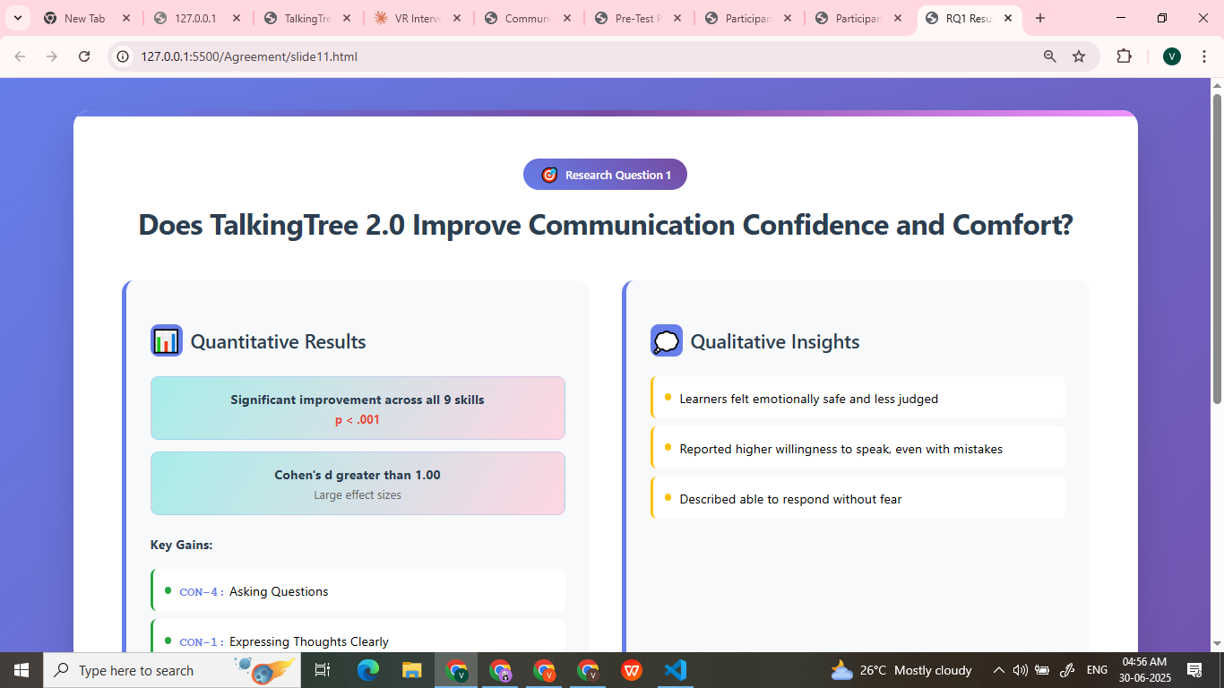
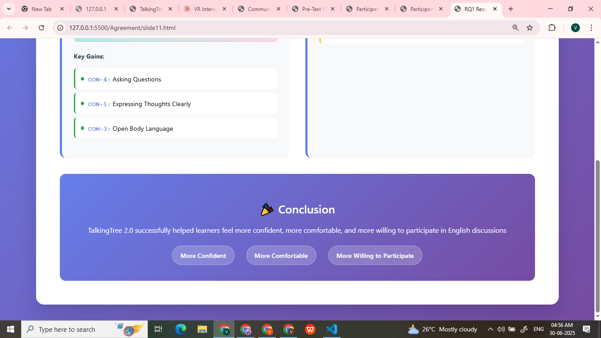
Does TalkingTree 2.0 Improve Communication Confidence and Comfort?
Notes:
In the Discussion section, we’ll now interpret what these results actually mean
“To answer our first research question — yes, intervention improved learners’ communication confidence and comfort.
Quantitative data showed large and meaningful improvements across all nine variables
These findings were supported by the interviews. Learners described They felt more ease, motivated to speak, and able to respond without fear.
So, it helped learners grow in both confidence and comfort.

Slide 31
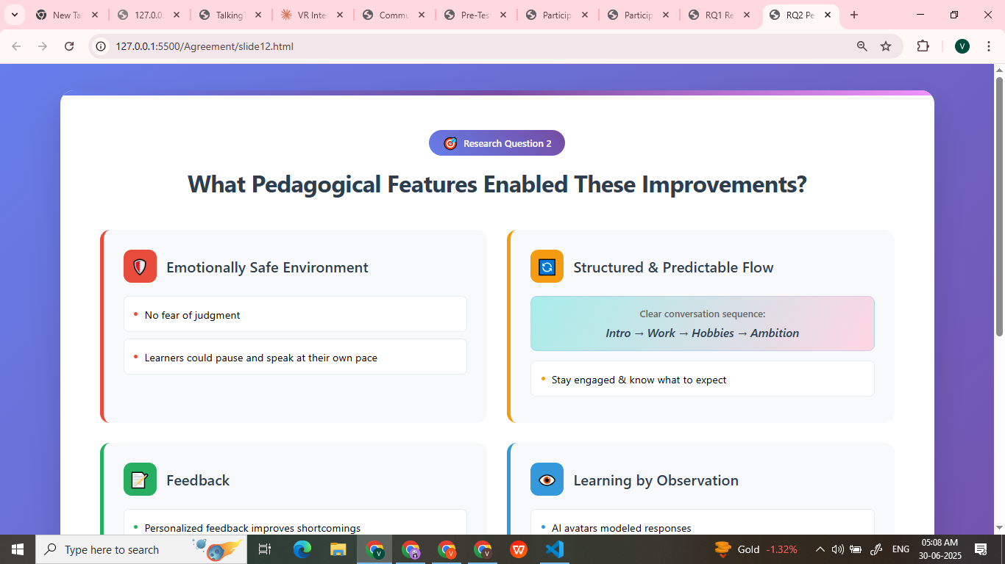

What Pedagogical Features Enabled These Improvements?
Notes:
Second RQ - What features enabled improvements
One factor was the environment. In VR, user described they felt free to speak without the fear of being judged.
The structured and relevant discussion flow helped them stay engaged and know what to expect.
Personalized and Real-time feedback help them to improve on their shortcomings.
And finally, by observing how the avatars are responding, learners trying using it, in their responses.
****************************************************************************************************************************************************8
"To answer the second research question, several features were identified as enablers of improvement:
a non-judgmental VR environment that encouraged speaking, a structured and relevant discussion flow, personalized real-time feedback,
and avatar responses that modeled effective communication for learners to adopt."

Slide 32

Limitations
Notes:
TalkingTree 2.0 showed good results, but there were a few limitations.
First, we only measured short-term improvement — we don’t know if the gains last or transfer to real-life situations. Second, the avatars lacked natural expressions and body language. Third is, system generates feedback for almost every input, even sometime not necessary. the speech was converted to text using an auto-correcting voice recognition system, So sometimes original grammatical mistakes were often lost.
Also, personalized feedback was given manually, which limits scaling. And finally, since the system needs a VR headset, which may not be easily accessible for all learners.
These are important areas to improve in future versions.
TalkingTree 2.0 worked well, there are some limitations
First, our study measured only short-term effects. We don’t yet know if the confidence gains last over time or transfer to real-life settings like interviews or classrooms.
Second, while the avatars were AI-powered, they still lacked expressive body language or emotional tone — which made the group interaction feel a bit robotic at times.
Technically, some voice inputs were missed, and feedback wasn’t always accurate. The system sometimes rephrased already correct responses, which could confuse learners.
Also, personalized feedback was manually given by the researcher and not yet built into the system — making it harder to scale.
Finally, since this requires a VR headset, accessibility could be a barrier — especially in rural or low-resource environments. These are areas for future work.”

Slide 33

Notes:
“To sum it up — This intervention worked.
We saw strong improvements in learners' confidence and comfort — both in how they rated themselves and how evaluators observed them.
And more importantly, participants told us that they felt the change. They felt safer, more willing to speak, and less afraid of making mistakes.
There are limitations also — but overall, TalkingTree 2.0 proved to be learner-centered tool for building communication confidence..
With the right improvements, it has the potential to scale and support even more learners in the future.”

Slide 34

Notes:
“Before I close, I want to take a moment to thank my guide, Professor Sridhar Iyer, for their constant support and mentorship throughout this journey. I’m also grateful to the TalkingTree 1.0 teammates (Suraj, Deepika and Alisha) — their early work gave this project a strong foundation. And a big thank for the participants who shared their time, thoughts, and experiences.
“Thank you so much for your time and attention..

